Slide 1

Integrated Software and Systems Engineering Curriculum
Innovations in Software Engineering Education
Lawrence “ Larry” Bernstein
April 24, 2009
lbernste@stevens.edu
www.GSwERC.org

Slide 2
Background
Software drives the performance of virtually all major systems.
Being able to produce software that can be trusted as reliable, secure, safe, correct, and available while being delivered on-time and within budget challenges academia government and industry.
Now creating new reference curriculum.

Slide 3
A software industry study
Software complexity is growing exponentially
Qualified developers are hard to find
  One choke point is middle software managers
Software education enrollment has experienced a 6 year decreasing trend
Software job categories are not standard
  Poorly defined, and do not generally reflect actual responsibilities
Poor quality developers (weak links) at any level increase program risk

Slide 4
Findings
There is no commonly accepted structure or content for graduate software engineering education
Each university establishes its own curriculum

Slide 5
Some observations from 28 Schools
SWE is largely viewed as a specialization of Computer Science
Few Faculty
Student enrollments are generally low compared to CS
The target student population varies widely - anyone with Bachelors and B average to someone with CS degree and 2+ years of experience
Online course delivery is popular
“Object-oriented” is the standard development paradigm - creating a “clash” with many systems engineering programs that emphasize structured methods

Slide 6
Programs have diverse focuses
Development of defense systems
Acquisition of defense systems
Embedded real-time systems
Entrepreneurial technology companies
Quantitative software engineering
Software economics
Safety critical systems
Secure software engineering
Highly dependable software systems
No focus dominates

Slide 7


Background
Software drives the performance of most systems.
Being able to produce software that can be trusted as reliable, secure, safe, correct, and available while being delivered on-time and within budget is a major challenge for both the government and industry.
Many steps must be taken to meet that challenge - including ensuring our workforce is well educated in software engineering (SWE) principles and practices.
Too many software efforts fail to meet their objectives!

Slide 8


Slide 9
Outcomes
Most programs prepare students to be practicing software engineers. Two prepare students to acquire software. Several prepare students to manage teams of software engineers or to be researchers.

Slide 10
Aspirations for graduates
Develop and modify large, complex software systems
Ethical and effective member of teams
Procure/produce highly dependable, trustworthy software/systems.
Understand and apply advanced SWE principles
Realize quality software products on time and within budget.
Research
Practicing software engineers and software process managers in industry and government
Future chief engineers, head designers, chief technical officers
Continue to learn and grow

Slide 11
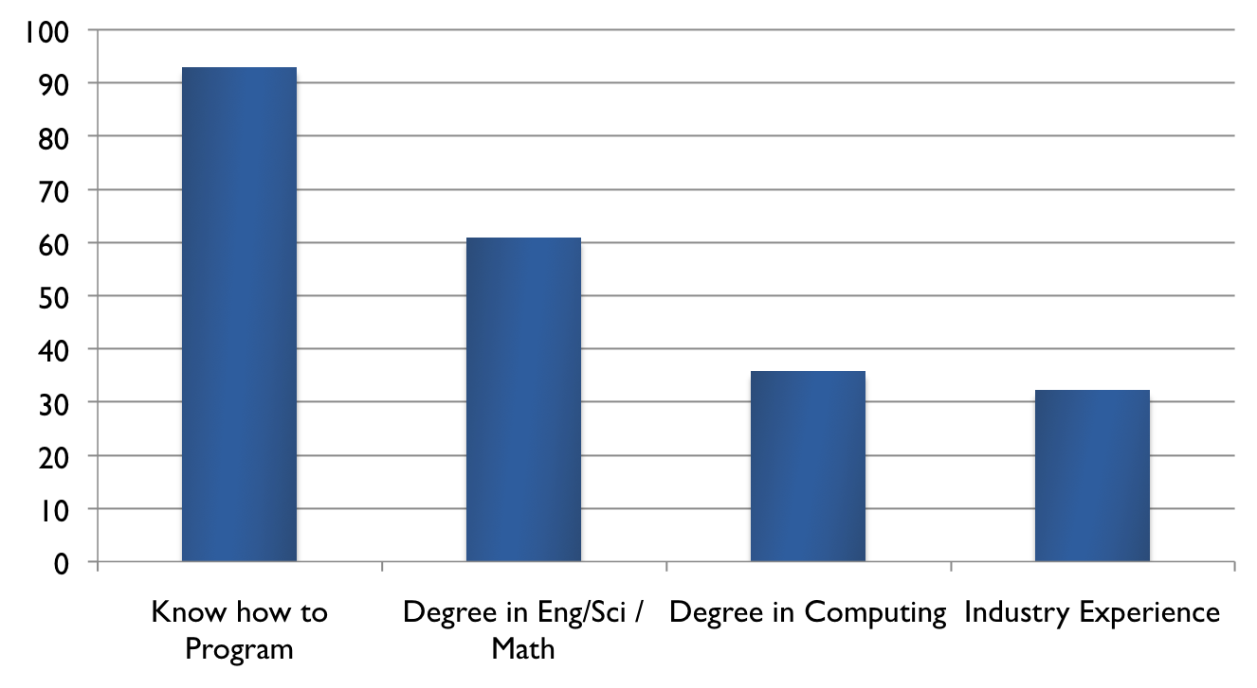
Different entrance requirements
Most programs offer leveling courses for students lacking entrance requirements
Many programs routinely waive academic requirements for students with industrial experience
%
Programs

Slide 12

iSSEc - The Way Forward
The Integrated Software and Systems Engineering Curriculum Project (iSSEc) is creating a reference curriculum leading to a Masters degree in software engineering

Slide 13
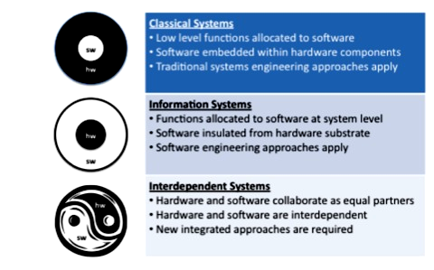
Systems and software engineering to become one

Slide 14
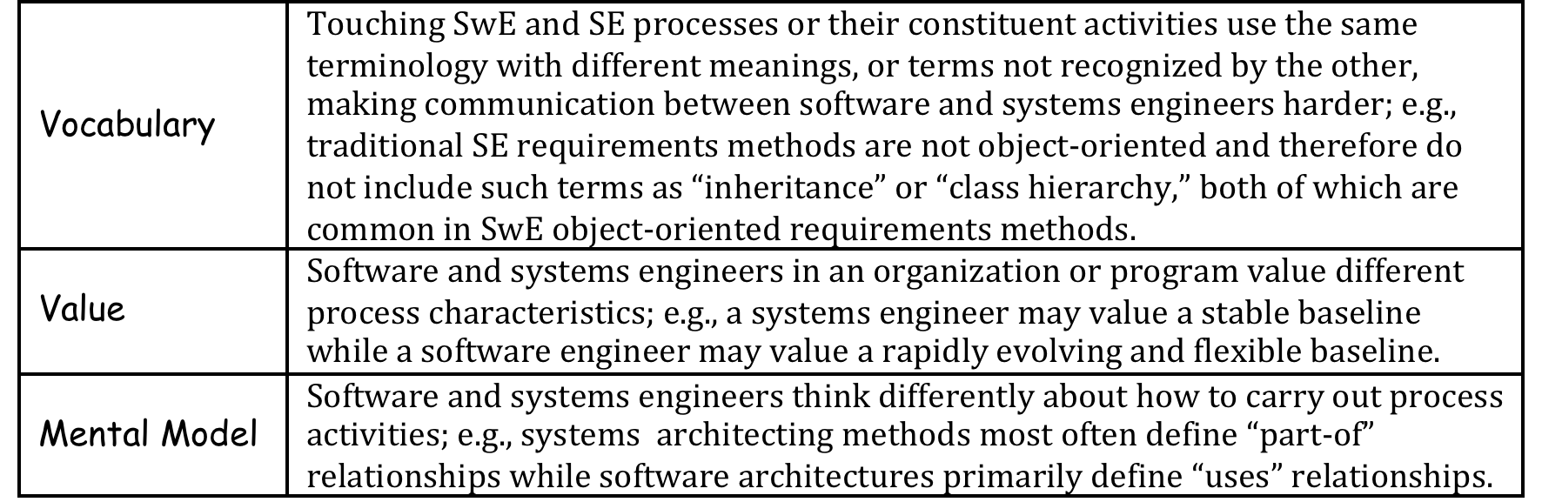
Clashes

Slide 15
Barriers
Prejudices
SE and SwE cultures differ
SE and SwE have different educational backgrounds
SE and SwE vocabularies are similar but different

Slide 16

People, Process, Project, Product
Account for 70-80% of software costs
20:10:5:1 productivity difference

Slide 17
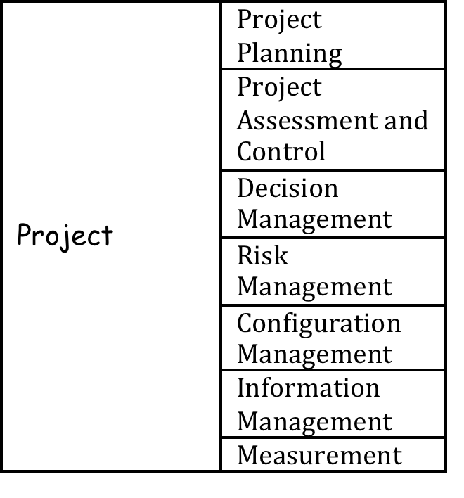
Project

Slide 18
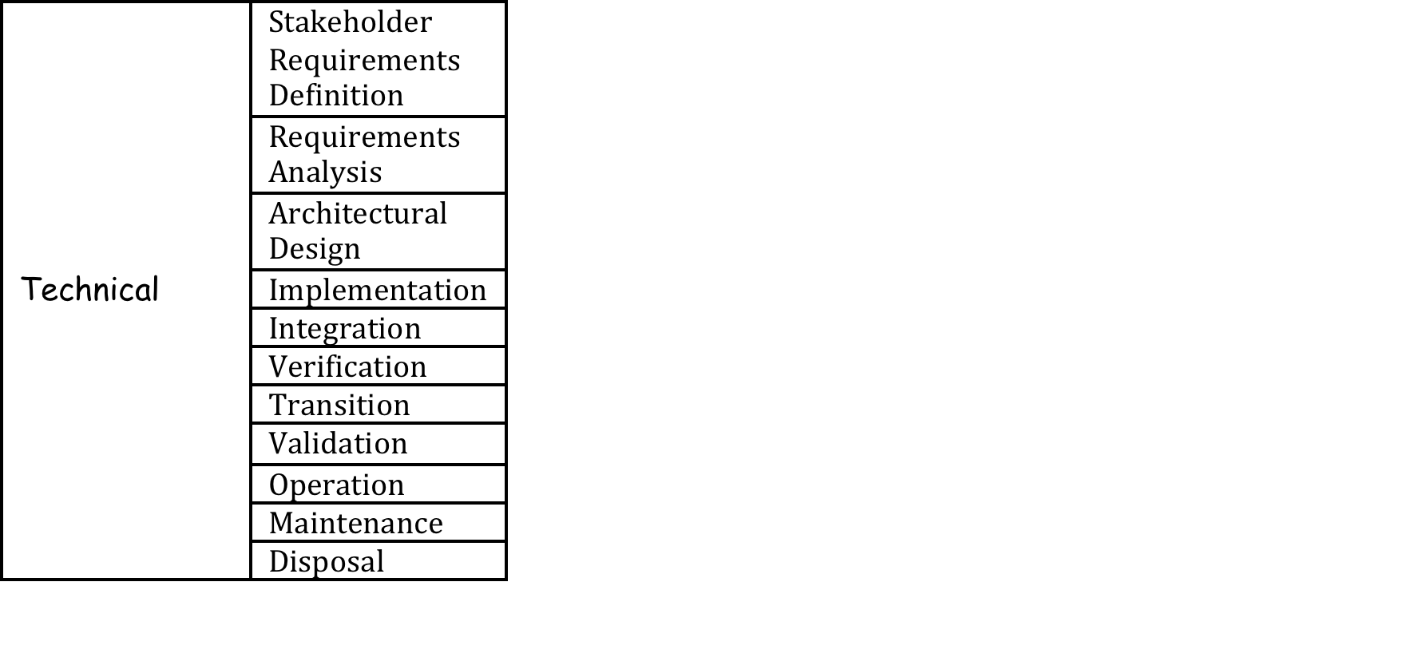
Process
Process
Incremental, Agile, Spiral, Waterfall, COTS, component based, FOSS

Slide 19
The Approach
Understand the current state of SWE graduate education
Create a strawman model curriculum,
Publicize effort through conferences, papers, website, etc.
Obtain endorsement from ACM, IEEE, INCOSE, NDIA, and other professional organizations
Create full model curriculum, suitable for global use, with a large representative team
Seek early adopters

Slide 20
Programs Prepare Graduates for Diverse Roles
Most programs prepare students to be practicing software engineers.
Two prepare students to acquire software.
Several prepare students to manage teams of software engineers or to be researchers.

Slide 21
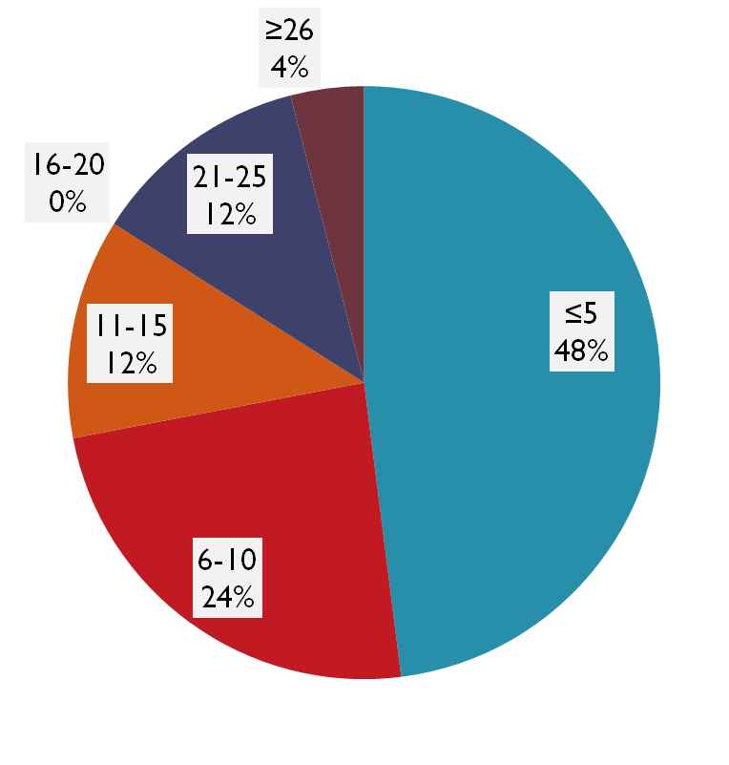
Number of Full-time and Adjunct Faculty
Many software engineering faculty also teach computer science
Heavy dependence on adjunct faculty
Most faculty have industry experience

Slide 22
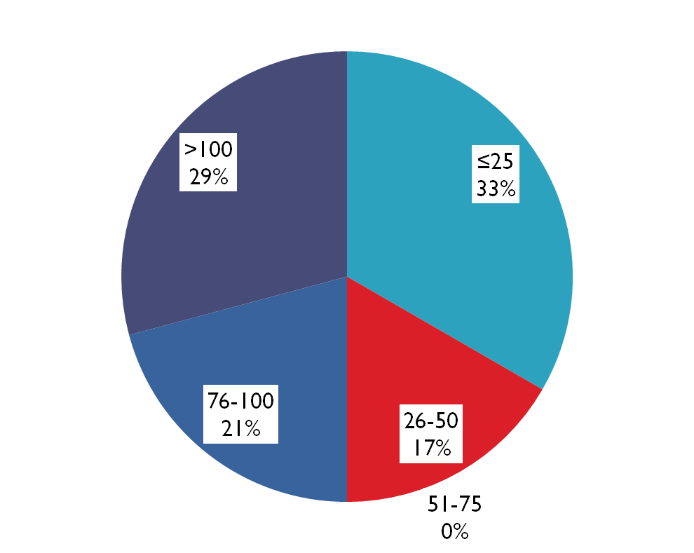
Number of Students Currently Enrolled

Slide 23
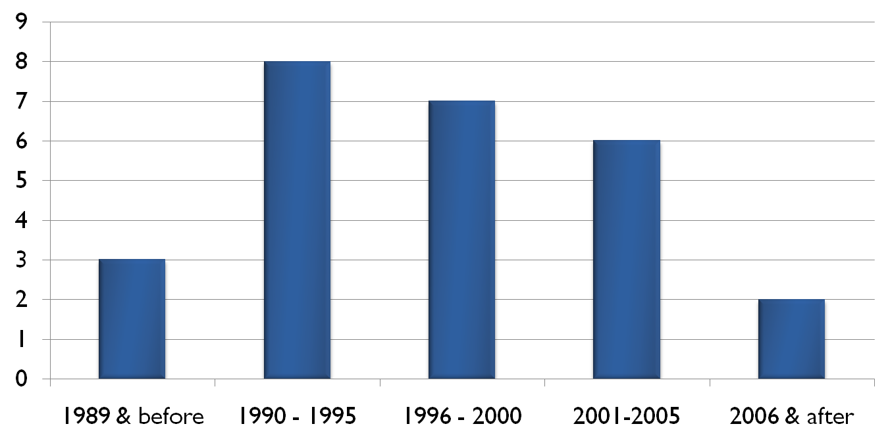
Year that Program Started

Slide 24
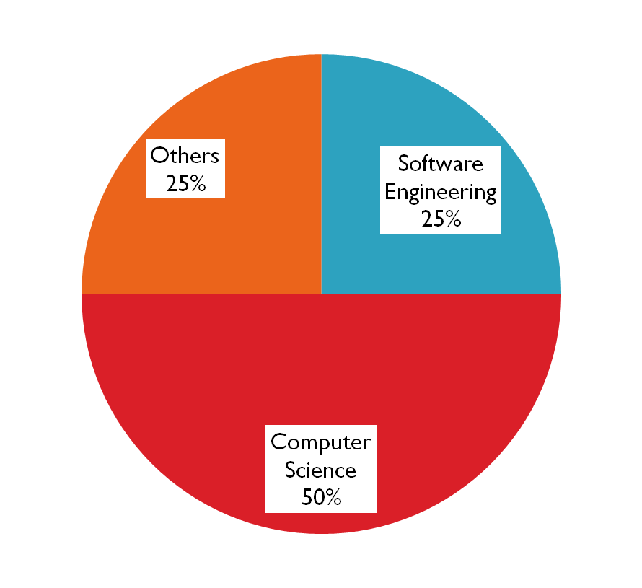
Department or School in which Degree is Offered
School of Systems and Enterprises (Stevens)
Dept. of Electrical and Computer Engineering (AFIT, Drexel, Mercer)
Dept. of Engineering and Information Science (Penn State – Great Valley)
Dept. of Information and Technology Systems (University of Maryland – University College)
Division of Professional Studies (Brandeis)
*Department or school names may vary slightly, but are close to “software engineering” or “computer science”

Slide 25
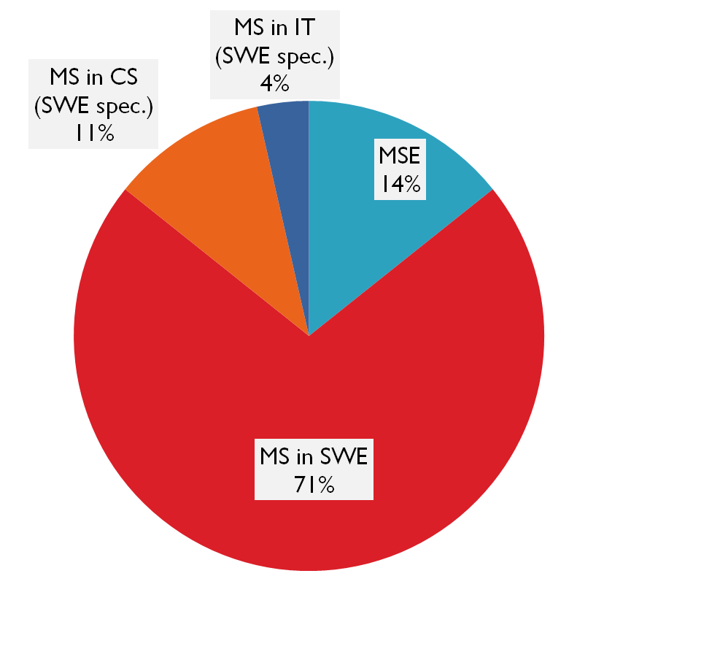
Degree Offered
MSE – Master of Software Engineering
MS in SWE – Master of Science in Software Engineering
MS in CS (SWE spec.) – Master of Science in Computer Science with specialization in Software Engineering
MS in IT (SWE spec.) - Master of Science in Information Technology with specialization in Software Engineering

Slide 26
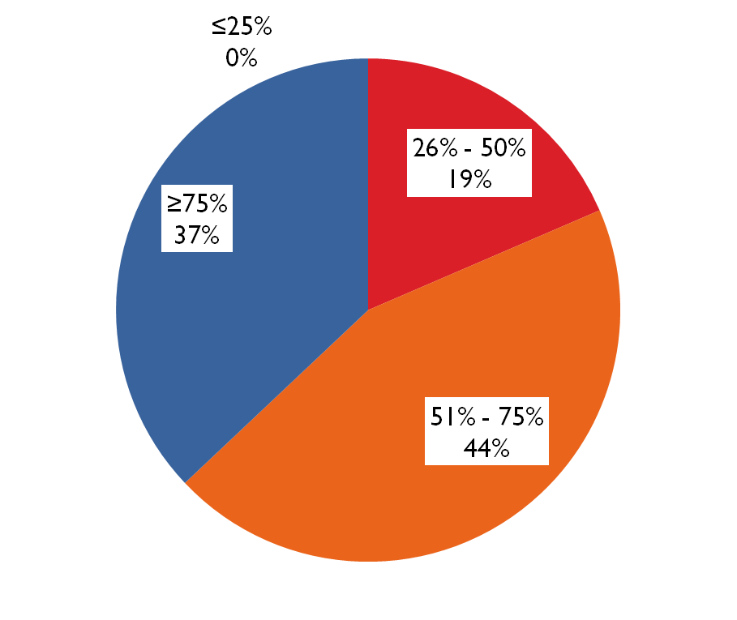
What Percentage of Courses are Required?
On average, students take 11.6 courses for the degree of which 8.3 are required.
For 43% of the programs, this includes a required thesis, project or practicum, which is normally the equivalent of 2 or 3 courses.
Required: Student must take the course
Semi-Required: 50% or more probability that course will be taken

Slide 27
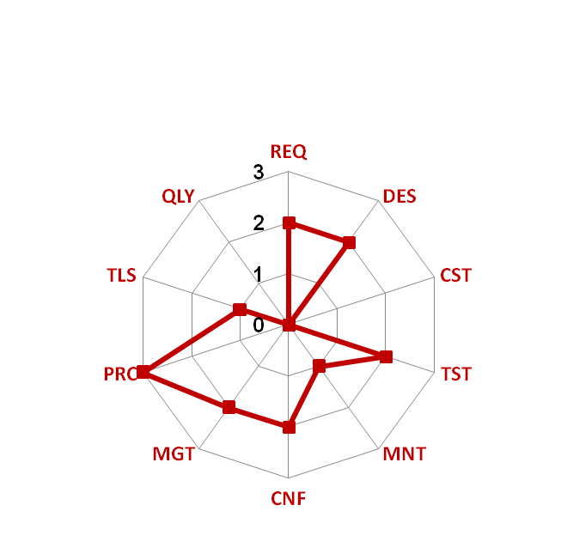
SWEBOK Coverage in
Required and Semi-Required Courses
  0: No coverage of topic
  1: Some coverage but no
  dedicated course
  2: One dedicated course
  3: Two or more dedicated courses
sample
Required: Student must take the course
Semi-Required: 50% or more probability that course will be taken
REQ | Sw Requirements
DES | Sw Design
CST | Sw Construction
TST | Sw Testing
MNT | Sw Maintenance
CNF | Sw Config. Mgmt.
MGT | SwE Management
PRC | SwE Process
TLS | SwE Tools and Methods
QLY | Sw Quality

Slide 28
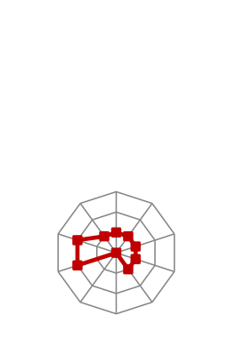





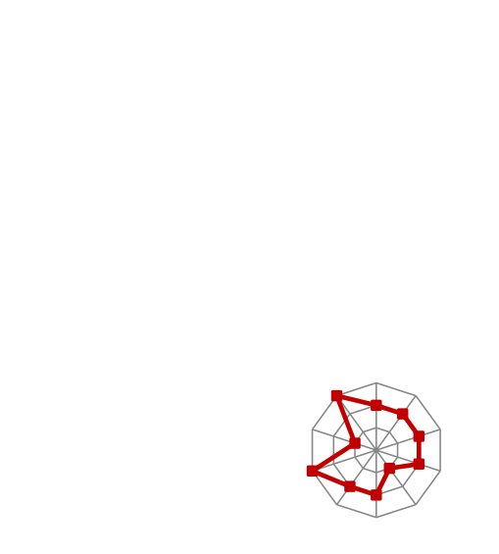





















SWEBOK coverage* in 2007 across
28 SwE MS programs
*Coverage in required and semi-required courses
Notes:
Study showed wide diversity in what is required/semi-required (>50% chance it is required) in master’s programs in software engineering. Schools were primarily in the U.S., but also included 3 from outside U.S. While some diversity is clearly good, especially at the graduate level, the high degree of diversity in today’s programs supports idea that reference curriculum is needed.

Slide 29
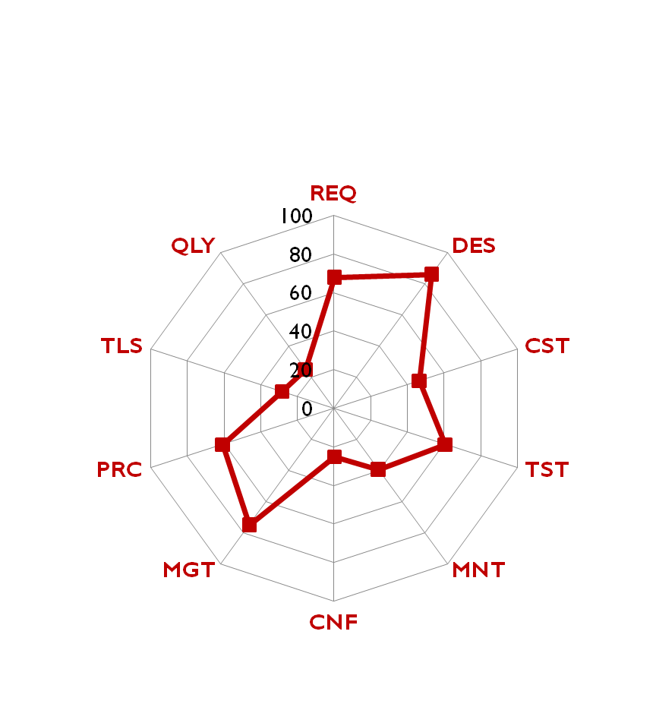
Composite SWEBOK Coverage in
Required and Semi-Required Courses
REQ | Sw Requirements
DES | Sw Design
CST | Sw Construction
TST | Sw Testing
MNT | Sw Maintenance
CNF | Sw Config. Mgmt.
MGT | SwE Management
PRC | SwE Process
TLS | SwE Tools and Methods
QLY | Sw Quality
% of Programs with one or more dedicated courses

Slide 30
Challenges
No consistency in coverage across programs
Requirements, design, and management are best covered
Maintenance, configuration management, quality, and tools are least covered

Slide 31
Some existing innovative courses
Reverse Engineering (Drexel)
Software Evolution and Re-engineering (Rochester)
Software Risk Assessment in DoD (NPS)
Structured Document Interchange and Processing (DePaul)
Avoiding Software Project Failures (Carnegie Mellon – West)
Mathematical Foundations of Software Engineering (Monmouth)
Global Software Development (Carnegie Mellon)
Professional, Ethical and Legal Issues for Software Engineers (Cal. State Univ. – Fullerton)

Slide 32
Software Engineering at Stevens
  Courses offered on-campus, on-line, on-site in both traditional and modular formats
  Master’s capstone projects: Publishable, linked with SSW research
  Intensify software engineering research

Slide 33
Software Engineering Curriculum Themes
:
  Integrate with Systems Engineering courses
  Quantitative Decision Making
  Estimation
  Trustworthiness: Security, Reliability & Safety
  Building, Acquiring and Integrating Large Systems
  Complexity Reduction and Management
  Industry-Specific Case Studies
  Hands-on Team Projects
  Usability
  Distributed Teams and Development (To be added)

Slide 34
Stevens graduates might be able to answer these questions
Is this proposed software centric system feasible?
If it is, how much will it cost?
If we are willing to pay, how long will it take to build and to deploy?
What is the development plan, especially the detailed schedule?

Slide 35
Systems engineering curriculum
INCOSE sponsored a graduate systems engineering (SE) reference curriculum published in 2007.
The SE curriculum development process did not have the scale of participation that GSwERC has and is limited by the fact that the INCOSE SE Body of Knowledge (see http://g2sebok.incose.org) is much less robust and mature than SWEBOK.
INCOSE would like to mature the SE body of knowledge, which would be a strong foundation on which to base an upgraded SE curriculum.
The U.S. Department of Defense is considering sponsoring a project to update and mature the SE body of knowledge with INCOSE and create a mature SE reference curriculum. The effort would be similar to GSwERC with open collaborative international participation and fully shared resulting intellectual property.
Other professional societies would be welcome to participate.

Slide 36
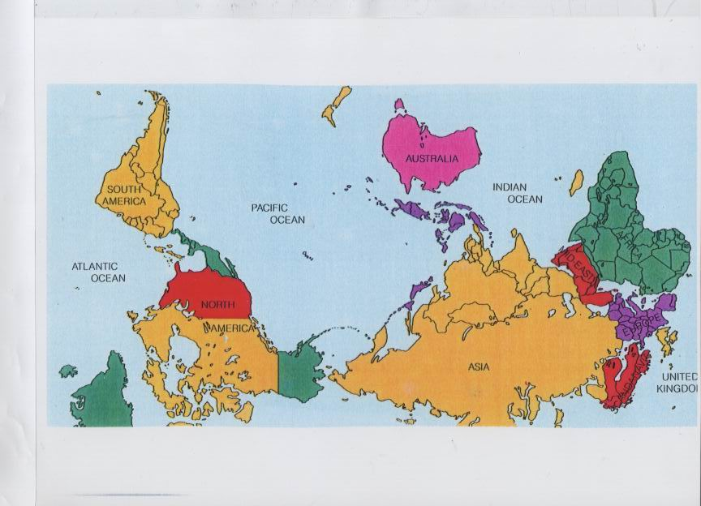
Questions, comments and expressions of support

Slide 37
Outcomes 1 to 4 at graduation
Mastered the Core Body of Knowledge
Mastered at least one application domain, such as finance, medical, transportation, or telecommunications, and one application type, such as real-time, embedded, safety-critical, or highly distributed systems. That mastery includes understanding how differences in domain and type manifest themselves in both the software itself and in their engineering, and includes understanding how to learn a new application domain or type.
Mastered at least one knowledge area or sub-area from the Core Body of Knowledge to at least the Bloom Synthesis level.
Demonstrated how to make ethical professional decisions and practice ethical professional behavior.
Notes:
There were 10 outcomes in version 0.5. They will undergo some modification in version 1.0 as a result of the review comments. For example, the term “Mastered” will probably be replaced by more descriptive and precise terms. There is, for example, no expectation that someone completing a master’s degree in software engineering will become an expert in an application domain if they weren’t an expert already when entering the program. However, by the time they complete the master’s degree, they should understand the vocabulary, key implementation issues, business characteristics, etc. of at least one application domain and how that impacts both the software and software development in that domain.

Slide 38
Outcomes 5 to 7 at graduation
Understand the relationship between software engineering and systems engineering and be able to apply systems engineering principles and practices in the engineering of software.
Be able to work effectively as part of a team, including teams that may be international and geographically distributed, to develop quality software artifacts, and to lead in one area of project development, such as project management, requirements analysis, architecture, construction, or quality assurance.
Show ability to reconcile conflicting project objectives, finding acceptable compromises within limitations of cost, time, knowledge, existing systems, and organizations.
Notes:
The tie to systems engineering is strong enough that it is reflected in an outcome. The SWEBOK does not contain information about systems engineering. Other reference material is being included in GSwERC to compensate.
There were many review comments that we should more clearly include both oral and written communications skills in the outcomes. Outcome 6 will probably be revised to do so, emphasizing its importance for team effort.

Slide 39
Outcomes 8 to 10 at graduation
Understand and appreciate the importance of feasibility analysis, negotiation, effective work habits, leadership, and good communication with stakeholders in a typical software development environment.
Understand how to learn new models, techniques, and technologies as they emerge, and appreciate the necessity of such continuing professional development.
Be able to analyze a current significant software technology, articulate its strengths and weaknesses, and specify and promote improvements or extensions to that technology.

Slide 40
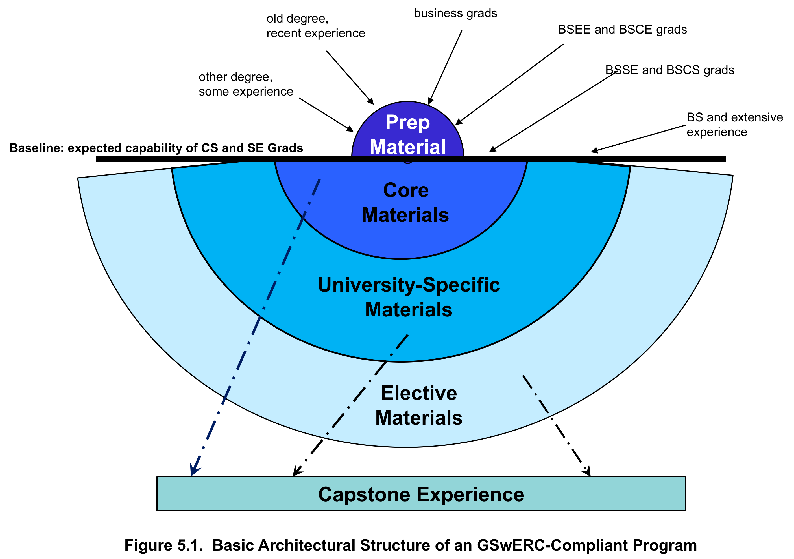
Curriculum architecture
Notes:
The Core Body of Knowledge (CBOK), represented in the middle of the diagram, should take up no more than 50% of the total time in the master’s program. That is the material that ALL graduate students should learn. It is specified through Bloom Levels from material taken from the SWEBOK 2004 plus supplementary material in systems engineering and other areas which are not adequately covered in the current version of the SWEBOK.
Restricting learning the CBOK to 50% of the time allows universities to add their own emphasis (e.g., James Madison University puts a strong emphasis on security) and allows students to select electives based on personal interest. Achieving the 10 outcomes is not accomplished solely through learning the CBOK. All of the program together is needed to achieve the 10 outcomes.
The capstone experience is a project or thesis. In most programs is likely to be a project where all the knowledge the student has learned previously can be applied to deepen the level of understanding and accomplishment.

